Slide 1

chapter 3 Introducing DevOps

Slide 2
Topics
Understanding DevOps
Building a DevOps culture

Slide 3









Software Development never ends...
Code
Deploy
Plan
Build
Operate
Release
Test
Monitor

Slide 4
Fast and loose start-ups
Slow and steady corporate
Nimble and reliable Best of both
What Problem Does DevOps Try to Solve?

Slide 5
Start-ups – Green Fields Ahoy!
Have a great idea
Develop it
Deploy it

Slide 6
Enterprise – Complexity Due to Scale
Have a great idea
Debate it
Get signed off to process
Develop it
Test it
Fix it
Scope out requirem-ents
Raise required paperwork
Get paperwork signed off
Fix it
Deploy as part of a release
Fix it
Test it as part of the release
Schedule the release

Slide 7

Devops as a new role? From the Dev’s Perspective
Developers that can maintain infrastructure
Continual delivery
Continuous integration
First Deployment
Monitored
Tested
Notes:
Adrian or Phil?

Slide 8

From the Ops Perspective
Ops staff that can code
Virtualisation
Cloud based
High availability
Testable
Maintainable
Reproducible
Notes:
Phil or Kat

Slide 9


From the QA / Tester Perspective
Testing as a shared responsibility
Testable
Monitored
Reproducible
Version managed
Maintainable
Notes:
Adrian or Phil?

Slide 10

From the BA / PM Perspective
Data that matters; visibility, improvement
High availability
Maintainable
Reproducible
Continuous improvement
Measurable
Notes:
Phil or Kat

Slide 11
Development
Testing
Operations
DevOps – We’re all in this together!
DevOps
Notes:
DW

Slide 12
Keep CALMS and do DevOps
DevOps – The C.A.L.M.S Lifecycle:
C – Culture
A – Automation
L – Lean
M – Measurement
S – Sharing
Notes:
https://devops.com/using-calms-to-assess-organizations-devops/
We will investigate these in the next few slides

Slide 13

Culture
Sharing the same
vision,
goals and
Incentives
Open, honest, two-way communication
Collaboration
Pride of work
Respect others
Trust others
Transparency

Slide 14
From | To
IT focus (inside-out) Silos Command and control Task-oriented Blame Reactive Content with the old Resistant to any change Low trust in others Covered up any failure Novelty is crushed | Customer focus (outside-in) Cross-functional teams Collaborative Outcome-oriented Taking on responsibility Proactive Courageous Flexible High trust Responsibilities are shared Failure reported and investigated Novelty is implemented
Change of culture
People don't resist change. They resist being changed. Peter Senge

Slide 15



It is important that instead of processes being adopted, it is adapted.
Evolve Experimentally
Jutta Eckstein
Implement Feedback Loops
Ignoring feedback merely means that the system will eventually experience a massive unpleasant surprise rather than a small unpleasant surprise.
John Gall
DevOps is Collective Responsibility
It's not the tools that you have faith in – tools are just tools. They work, or they don't work. It's people you have faith in or not.
Steve Jobs
Notes:
Coach, Consultant, Speaker, Author: Company-wide Agility with Beyond Budgeting, Open Space & Sociocracy (@agilebossanova) & other books on agile dev. she/her. Brunswick, Germany.
Quick feedback should be the first thing you introduce.
It is important that instead of the process being adopted it is adapted.
Starting with really short cycles seems to help implement the change to an agile process. If the cycles are short it is very difficult for the whole team to fall back into its old habits.
Learning and change processes are part of each other. Change is learning process and learning is a change process.
A plan is nothing; planning is everything.
If a project is on time and in budget it doesn't mean it was a successful project, but a successful estimate.
Methodologies do not produce skilled developers.

Slide 16




S – Sharing
“Knowledge is experience, everything else is information.”
Albert Einstein
Customer needs, feedback, app info, release info, bug fixes….
Business
Design
Dev
Test and
Release
Ops
Manage
Plan
Build
QA
Support
Revenue, engagement, device info, performance info, crashes….
Notes:
Sharing information should go further than just sharing in IT. Every function in a ‘sharing’ business is accountable for software success and so it’s essential for feedback and feed-forward to and from line of business teams in marketing and product management. We should make sure that the information from monitoring and from our application analytics solutions is shared with anyone in the business.
To adopt DevOps successfully, you need to focus on BizDevOps and the feedback and feed-forward loops should look like this.
Sharing
Sharing, overlaps with culture.
Are different teams within DevOps working together and communicating?
Sharing is not always easy. I want to get my own work done without necessarily thinking about the team.

Slide 17
Develop
Test
Release
A – Automation
Tools make automation possible
Amazon push code to production every 11.7 seconds
Notes:
Automate: deployment, infrastructure, builds, deployment, configuration, document management
Benefits: testability, recoverability, consistency, reduction in workload, fewer incidents, greater accuracy
Netflix is well-known DevOps case study. It can deploy code and software updates in minutes across its entire infrastructure.
Deploying too fast is risky and automation needs to take this into account.
Continuous Integration practices allow for continuously releasable software through incremental build and test.
Code in the 'mainline' branch of the version control system is always ready for release, through the use of automated tests that run whenever a developer checks in their code. Many teams use a dedicated CI environment for this purpose
Continuous Integration, by Paul Duvall, with Steve Matyas and Andrew Glover.
http://martinfowler.com/articles/continuousIntegration.html#PracticesOfContinuousIntegration
http://guide.agilealliance.org/guide/ci.html

Slide 18
What stops us?
“It’s too complicated.”
“I’ll break it.”
“What’s with all this code?”
“What is GitHub?”
“That’s not my responsibility.”
“Above my pay grade”
Reasons why organisations fail to change

Slide 19
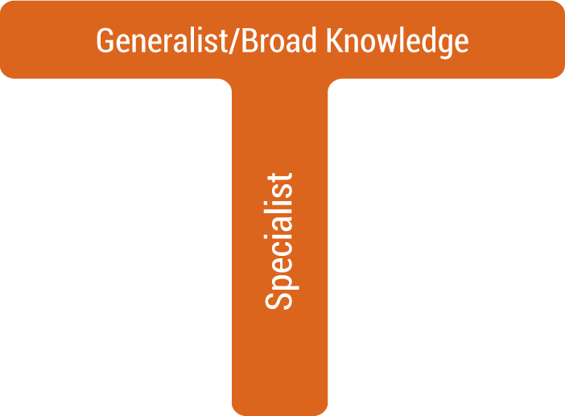

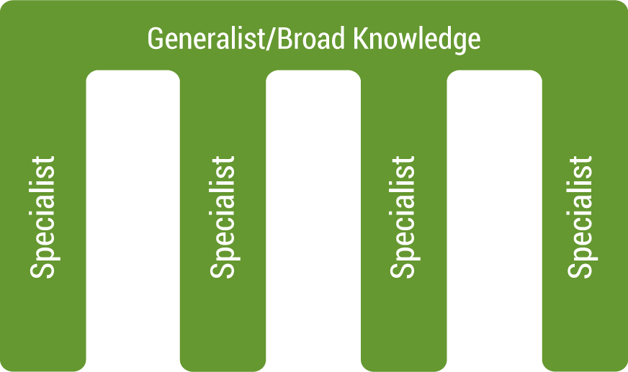
We Need Rounded Web Professionals
The agile world demands multifaceted teams
No-one working in development can choose not to be involved end-to-end

Slide 20

The type of Skills Required are Different
Developer
Operations
BE THE UNICORN
Notes:
http://torquemag.io/be-the-unicorn/

Slide 21
L – LEAN – Works With Agile
1. Eliminate Waste
2. Build Quality In
3. Create Knowledge
4. Defer Commitment
5. Deliver Fast
6. Respect People
7. Optimise The Whole
Mary and Tom Poppendieck
Notes:
Document cost savings by eliminating unneeded resources. DevOps can help companies with lean operations.
There is always the risk of being too lean and errors.
Respect people: Courtesy, listening, developing people and developing a no blame culture.
7. Maximise profit for the share holders or Creating value for end-use, customers by eliminating waste, unevenness, and being unreasonable.

Slide 22

Continuous Improvement
Continuous improvement
Kaizen – 'good change’ – continuous improvement mindset
Targeting areas for improvement
Bottlenecks
Waste elimination
Reduction of variability
Taiichi Ohno – the father of Lean

Slide 23
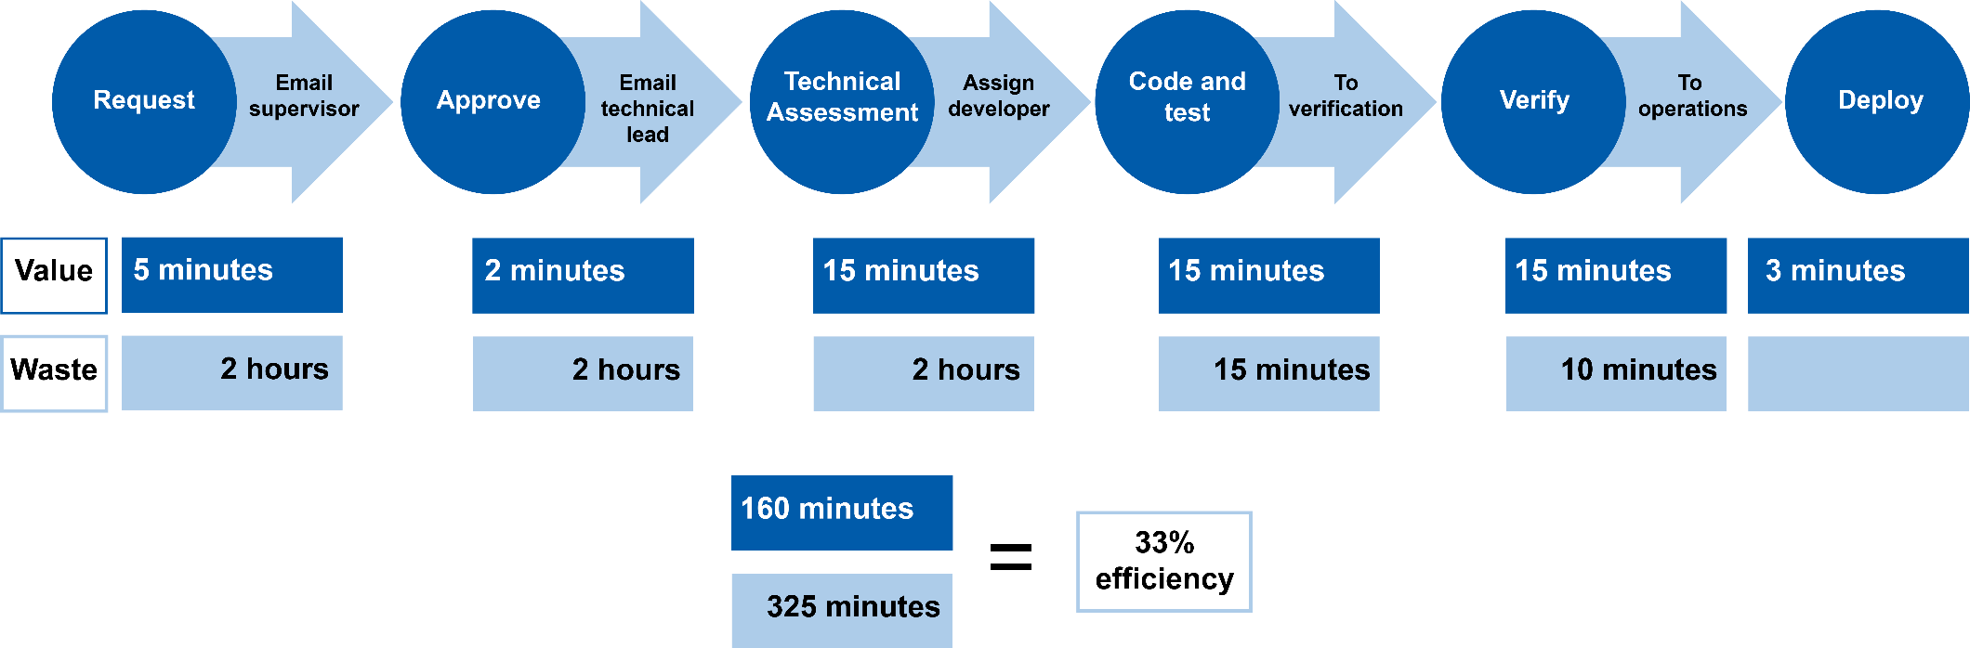
Example – Value Stream Map

Slide 24
We Use Tools for Reasons
Automation
Orchestration
Configuration
Testing
Logging and monitoring
Continuous integration
Continuous delivery

Slide 25
Specification
Test (BDD) code
Exploratory testing
Integration test
Deploy and test
Build and test
Monitor (test)
Test Based DevOps
Notes:
Exploratory testing is an approach to software testing that is often described as simultaneous learning, test design, and execution. It focuses on discovery and relies on the guidance of the individual tester to uncover defects that are not easily covered in the scope of other tests.

Slide 26
Organisation evolving into DevOps practice should use:
An automated testing framework focused on behaviour A strategy that focuses engineers on testing
Applications designed from the bottom up to be testable
Configuration management solutions that allow rapid creation and deployment of any environment
Dashboards to display and monitor the status of the system
The Next Gen DevOps Lifecycle

Slide 27
THANK YOU
Hope you enjoyed this learning journey.

Slide 28
What is NoOps?
NoOps stands for no operations
IT environment can be so automated and abstracted that no dedicated in-house team is needed to manage software
Main drivers are IT automation and cloud computing

Slide 29
What is WebOps?
WebOps, short for Web Operations
Focuses on the development, deployment, maintenance, and scaling of web applications. It enhances efficiency and performance through automation and specialised web tools
The area of WebOps engineering includes:
Application deployment
Management
Maintenance
Configuration
Repair

Slide 30
Simian Army
Software that reap havoc on their production systems
A new approach to architectures – microservices
Teams must clearly understand what service failure means to the system as a whole
Live service testing is becoming a new norm – Netflix simian army used to test resilience and monitoring
A lot of real-time monitoring
Detect – requests/second, and transactions/second
Respond
Performing “semantic monitoring”
Run subset of automated tests against live system
A Lesson from Netflix
Notes:
Latency Monkey induces artificial delays
Conformity Monkey finds instances that don’t adhere to best-practices and removed
Doctor Monkey health checks each instance as well as monitors other external signs
Janitor Monkey makes sure their cloud is running free of clutter and waste (unused resources).
Security Monkey finds security violations or vulnerabilities
Chaos Gorilla simulates an outage

